Slide 1


Machine Learning–Based Food Health Scoring with Expert Nutritionist Validation

Slide 2

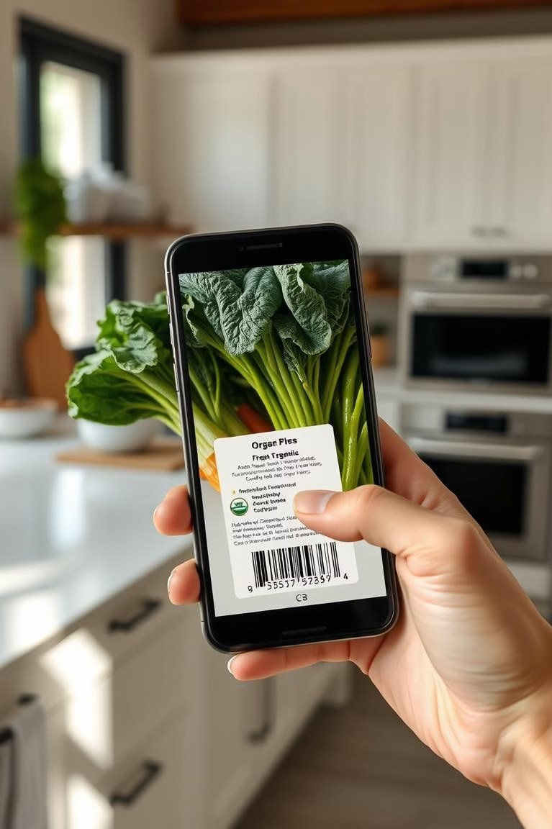
Introduction
The Child Food Product Barcode Scanner with Ingredient Simplification and Health Scoring is an innovative and practical solution designed to address the growing concerns of parents regarding the health and safety of their children's food. In today's fast-paced world, deciphering complex ingredient lists and evaluating nutritional content on food packaging can be challenging for parents who wish to provide healthy meals for their children. This app seeks to simplify this process by leveraging barcode scanning technology to instantly retrieve detailed product information, including ingredients, allergens, and nutritional values.
Photo by Pexels

Slide 3

Problem Statement: A Barcode Scanner for Ingredient Transparency and Health Scoring
Child nutrition is critical for healthy development, yet deciphering the ingredients and nutritional values of packaged food products remains a daunting task for parents. Labels are often complex, laden with scientific terms, and provide insufficient guidance on allergens, dietary restrictions, or overall health impacts for children. This lack of clarity can lead to uninformed choices that negatively impact a child's diet. The challenge lies in providing parents with a tool that simplifies ingredient information, highlights potential allergens, and assigns a health score for quick and informed decision-making during product selection.
Photo by Pexels

Slide 4
Solutions
The Child Food Product Barcode Scanner app addresses these gaps by offering a more tailored and innovative solution. It provides a user-friendly experience with a comprehensive, up-to-date product database and an intuitive barcode scanning feature. Unlike existing apps, it simplifies ingredient lists into easy-to-understand terms and includes a machine-learning-based health scoring system that evaluates products holistically, considering nutritional content, harmful additives, and beneficial ingredients. Customizable alerts for allergens and dietary preferences ensure that parents receive highly relevant recommendations. By integrating advanced technology with practical features, this app goes beyond generic solutions to meet the specific needs of parents, empowering them to make confident, informed decisions about their children’s nutrition. Its focus on transparency, personalization, and ease of use sets it apart, making it a much-needed tool in the crowded landscape of food-related apps

Slide 5
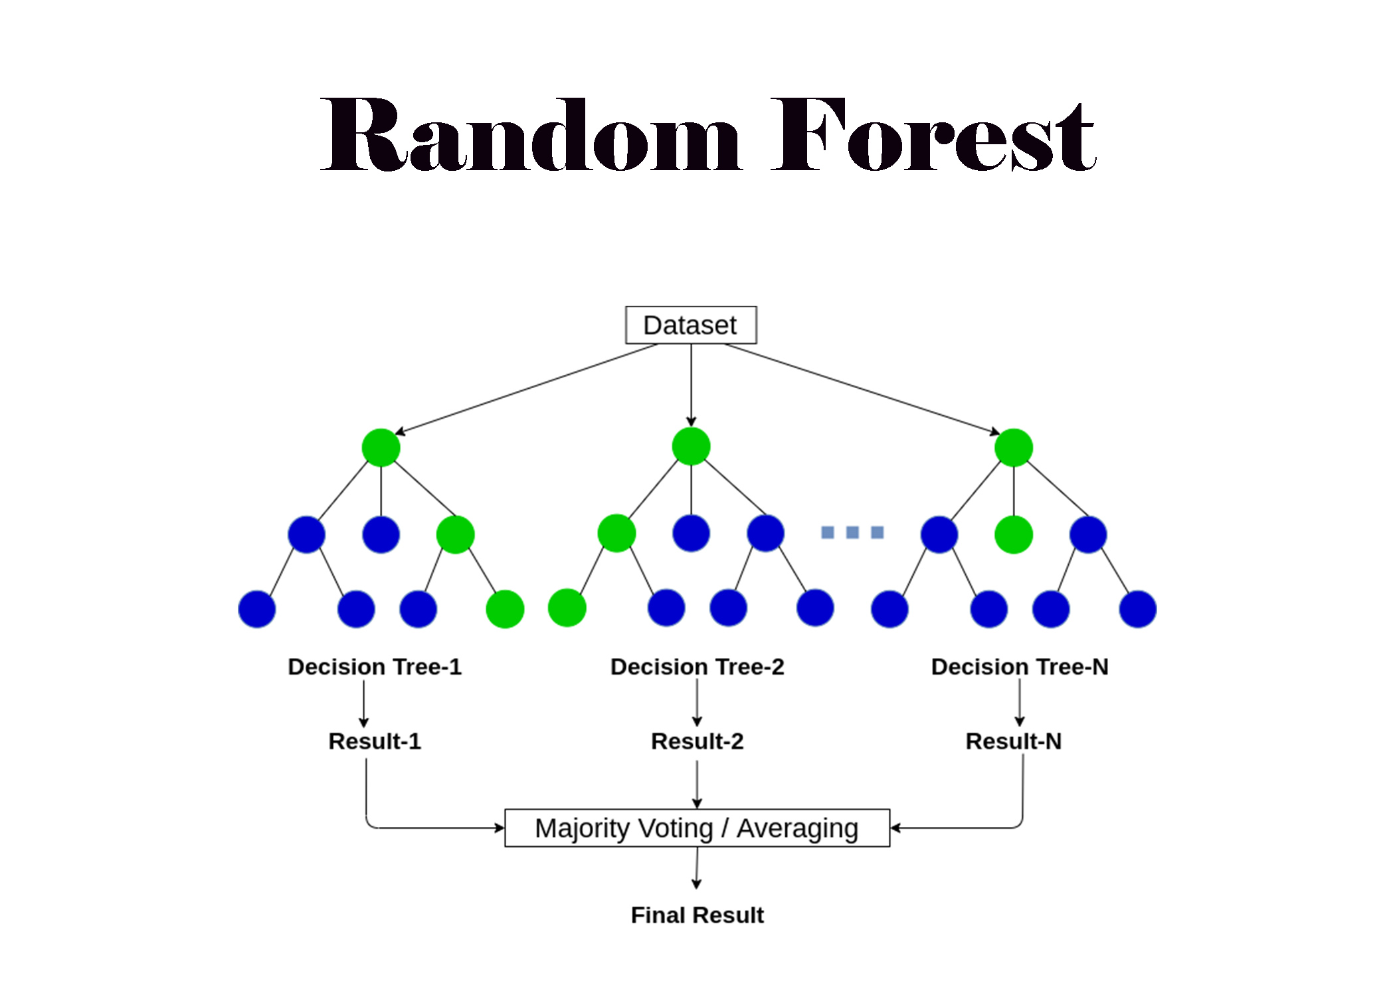
Models Used
The machine learning model used in your code is a Random Forest Regressor from the sklearn.ensemble module.
Model Type: RandomForestRegressor — This is an ensemble learning model that combines multiple decision trees to make predictions. It is used for regression tasks, where the target variable is continuous.
Purpose: In our pipeline, the RandomForestRegressor is used to predict the health score based on various nutritional features like sugars, fat, calories, protein, fiber, and carbohydrates.
Photo by Pexels

Slide 6
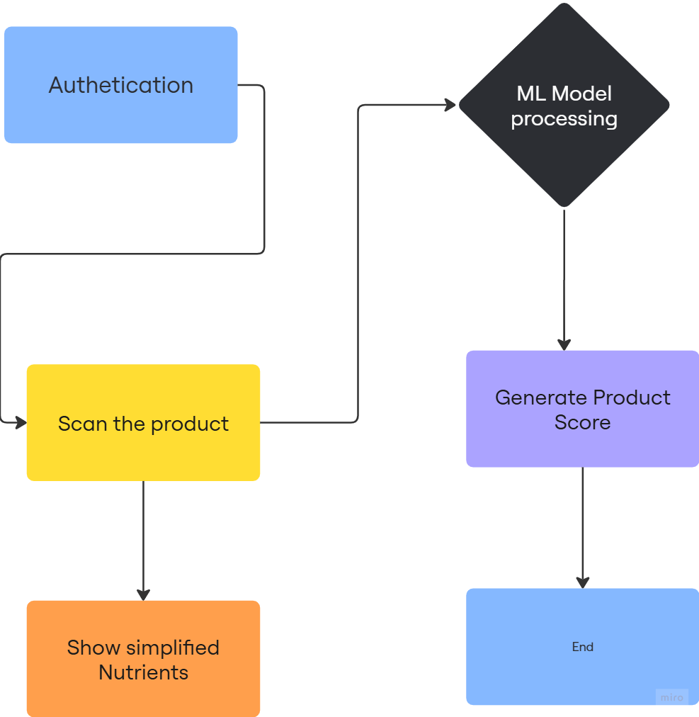
FLOWCHART:
Photo by Pexels

Slide 7

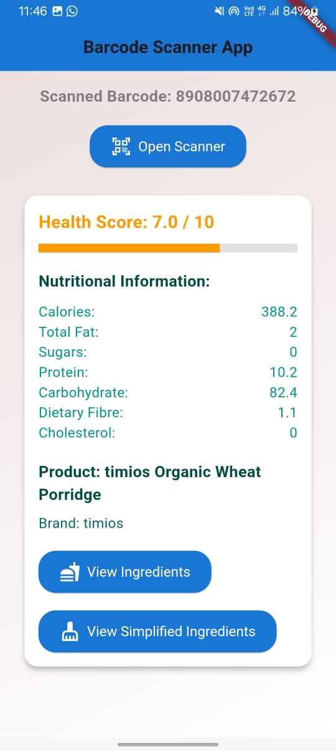
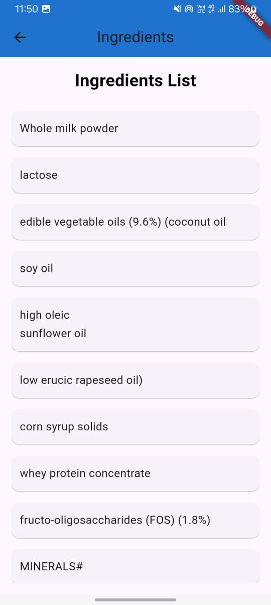
Implementation
Photo by Pexels

Slide 8

Future Scope:
1. Integrate the app with fitness tracking, meal planning, and recipe recommendation features to provide a holistic health and wellness solution.
2. The app can contribute to improved public health by enabling more informed food choices and supporting the management of chronic conditions.
Photo by Pexels

Slide 9
References
1. https://world.openfoodfacts.org/discover
2. https://ieeexplore.ieee.org/stamp/stamp.jsp?arnumber=9300155
3. https://spoonacular.com/food-api
4. https://www.ncbi.nlm.nih.gov/pmc/articles/PMC10260744/
5. https://www.hackster.io/kutluhan-aktar/barcode-based-nutrient-profiling-and-food-labelling-w-tf-28a371
6. https://lasy.github.io/files/papers/2018_Lazzari.pdf
7. https://www.scandit.com/resources/case-studies/yuka/
8. https://www.sciencedirect.com/science/article/pii/S019566632400374X
Photo by Pexels

Slide 10

TEAM MEMBERS
Cleon Lopes-60004220071
Dev Popat-60004220206
Jai Jain-60004220194
Rushabh Mehta-60004220247
Photo by Pexels

